Slide 1
Prehospital Use of Kcentra for Traumatic Bleeding & Shock Principal Investigator: Sam Arbabi, MD Harborview Medical Center
Appendix 8: Community Consultation Slides

Slide 2
What is this forum about?
To seek your opinion on the potential involvement of yourself or a family member in a research study of a novel IV treatment for patients that suffer traumatic shock from blood loss, that will be done under Exception From Informed Consent Requirements for Emergency Research (EFIC) guidelines.

Slide 3
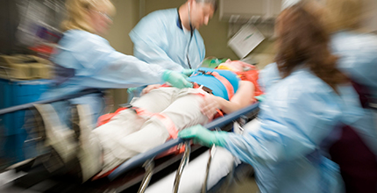
Traumatic Injuries
Trauma is the leading cause death for persons between the ages of 1 and 44 years.
Severe bleeding, head and spinal cord injuries, or a combination of these result in 80% of trauma deaths.
More than half of trauma deaths occur within the first 12 hours after the injury.

Slide 4
Hemorrhage
The most preventable death after trauma is exsanguinating hemorrhage–severe bleeding that leads to shock.
Two types of bleeding – internal and external
Signs of shock - low blood pressure, fast heart beat, confusion, pale skin, feeling cold
Tourniquet

Slide 5
Hemorrhage
There are currently no direct methods for controlling bleeding resulting from internal injuries in the field.
External bleeding is managed with pressure dressings, tourniquets, and other methods.
Tourniquet

Slide 6
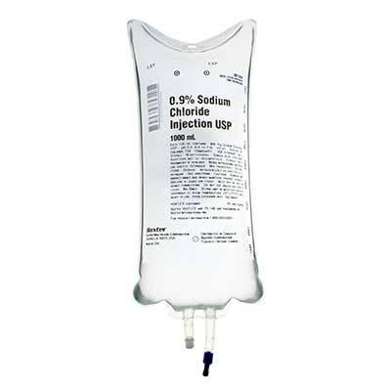
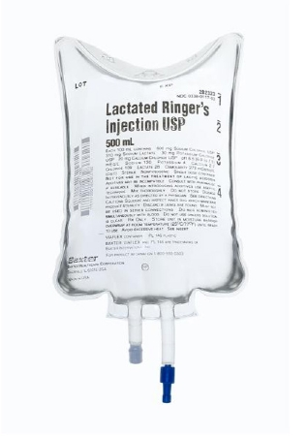
Treatment of Severe Blood Loss
IV fluid administration
Purpose: restore blood volume
Types: Normal Saline (salt solution) or Lactated Ringers (balanced solution)
Current guidelines: high volume resuscitation of two or more liters of fluid

Slide 7

Current Science & Studies
Is high volume resuscitation the best practice? Probably not.
Studies have shown that….
High fluid administration is associated with poor outcomes
Delayed and low fluid is beneficial until bleeding is control
Low fluid resuscitation has the potential to improve survival in patients with blunt trauma

Slide 8
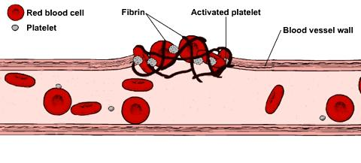
Significance of Research Study
When internal bleeding occurs, the body attempts to stop the flow by forming a clot.
Giving patients large amounts of fluid can minimize clot formation by:
Diluting the blood
“Pop” open the holes plugged by clots
Damage the structural integrity of blood vessels

Slide 9
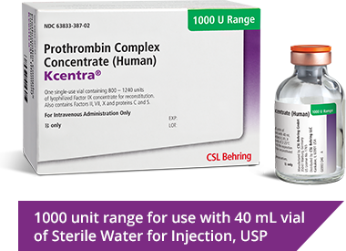
Significance of Research Study
An effective way to reduce bleeding and promote clot formation is the use of Prothrombin Complex Concentrate (Kcentra).

Slide 10
Significance of Research Study
What is Kcentra?
Kcentra is a powder with four components that helps blood clot.
It is quickly reconstituted with water in a vial and given in a very small volume (40ml).
In addition to blood clotting, studies have shown that Kcentra can also help repair the blood vessel following hemorrhagic shock
Notes:
What is a standard dose of Kcentra for reversing Coumadin? Is it more than 40 mL?

Slide 11
Goal of the Research Study
The primary goal of the trial will be:
To determine the feasibility and safety of Kcentra administration for the early treatment of patients with traumatic shock, compared to placebo

Slide 12
Study Trial Design
Randomized controlled trial (a common method used in clinical research).
A blinded vial containing either Kcentra or placebo will be reconstituted and given to the patient, followed by low volume resuscitation (250 mL of saline)
EMS personnel will give the treatment before patient arrives to the hospital.

Slide 13
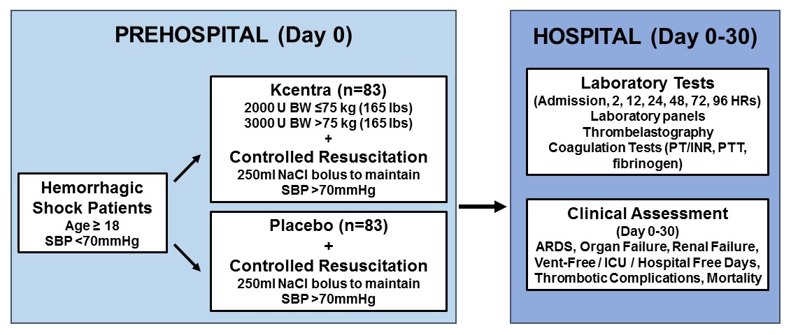
Study Trial Design

Slide 14
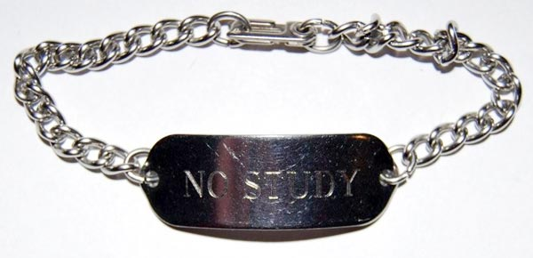
‘Opt-out’ Option
A “No Study” bracelet will be provided for those who request one.
*To request a bracelet,
call 206-897-1779 or email boost3@uw.edu

Slide 15
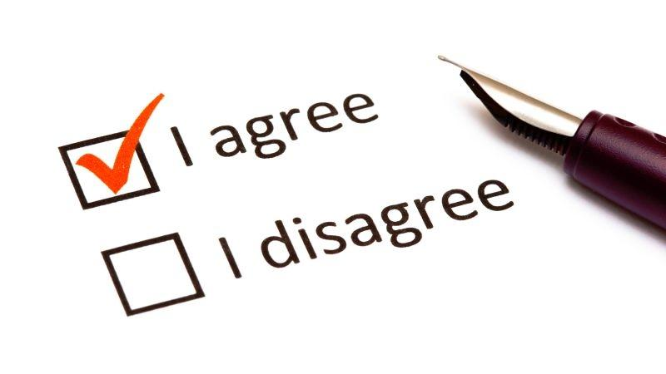
Notification and Consent
Will be obtained soon as possible after enrollment.
Subject can withdraw at any time.
Consent is obtained for research blood draws and continued review of your medical record, and only related to the current admission.

Slide 16

Safety Monitoring
The study will be monitored by:
Data Safety Monitoring Board (DSMB)—an independent group
Institutional Review Board (IRB)
Food & Drug Administration (FDA)

Slide 17
Exception From Informed Consent (EFIC)
A federal regulation (21 CFR 50.24), allows certain studies that meet the following criteria to use this exception:
Patients’ lives must be at risk.
Available treatments are not satisfactory.
Patients are unable to give consent.
Potential risks are reasonable.
Participation in the research could provide a direct benefit (increased survival) to the patient.
The research could not be carried out practically without this exception.

Slide 18
Exception From Informed Consent (EFIC)
Require community input and commentary for the proposed research.
Public disclosure
Community consultation
Eligible patients for this study will require immediate resuscitation, since without intervention, patients in shock face imminent death.
Traditional informed consent is impossible because:
Patients with severe traumatic injury are unconscious, or in shock and not capable of providing consent.
Resuscitation has to be started immediately, and next of kin may not be immediately available, or are likely to be too distraught to understand an explanation of the study.

Slide 19
Questions?
Do you have any concerns regarding this proposed research study?

